Slide 1
Analysis of Social Network
Ramazan Bozkurt-200254031
Abdulkadir Sözgen-210254031

Slide 2
Research Question
Who would be the first person we would call when we wanted to play an exhibition match among the players of the Turkish National Football Team who played in the last 5 World Championship tournaments?

Slide 3
Data Collection Instrument/Method
Our data handpicked from the transfermarkt.com website.
This is because the Football Players that played in the tournaments are already determined, and they are in the transfermarkt.com.
We use Excel which makes editing easy.

Slide 4
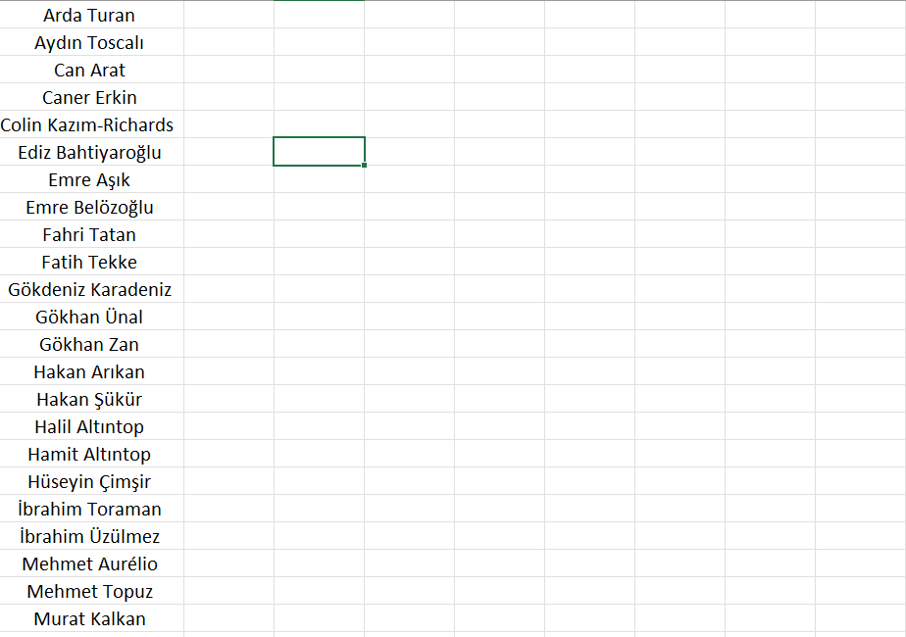
What are we doing with data?
First of all, we collect the players of the tournament.

Slide 5
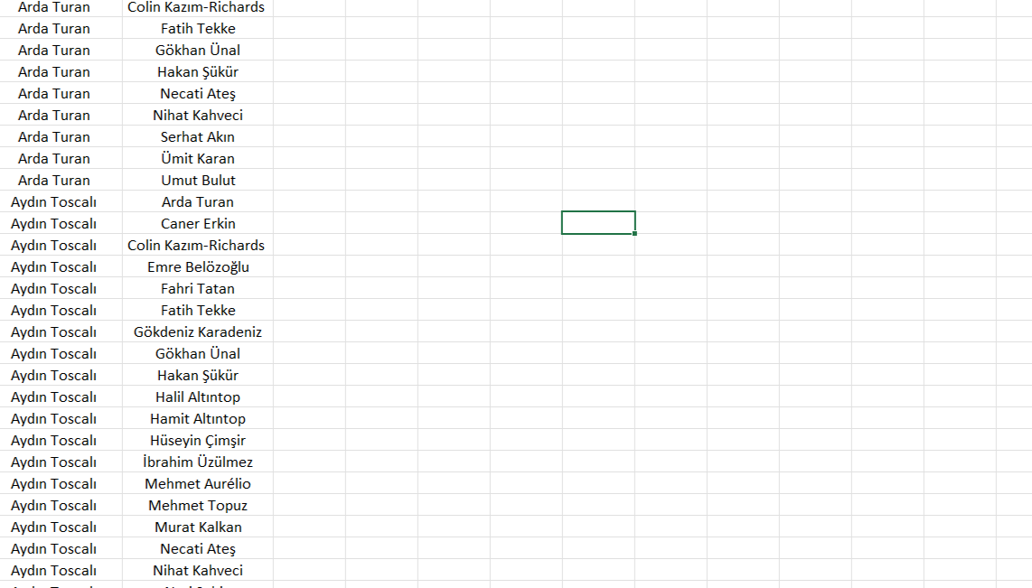
What are we doing with data?
Then we show all the edges to make an edge list.

Slide 6
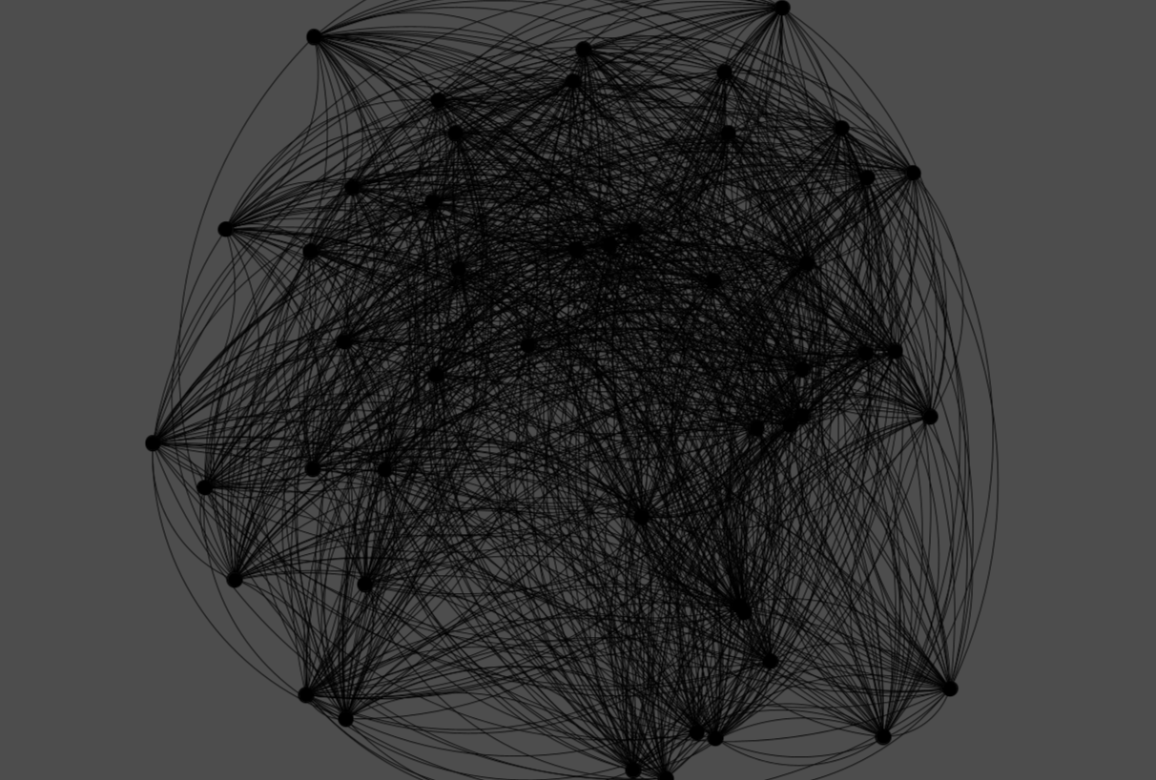
What are we doing with data?
After that we make the Graph.

